Slide 1
Unicorn Badminton Club
Recommendations and Analysis to Help Modernise Their Digital Presence.
Notes:
WHEN MARKING PLEASE RUN THE SLIDE SHOW IN SLIDE SHOW MODE AS ELEMENTS ARE COVERED UP AND ARENT ALWAYS SPECIFICALLY REFERENCED IN NOTES

Slide 2
Introduction
This presentation examines the Unicorn Badminton Club website, to understand how usable and accessible it is, while carefully looking into how to improve its performance.
It also considers how effectively the site communicates its purpose, assessing whether the current design, content, and structure of the content support the club’s goals.
By analysing these areas, the presentation aims to highlight weaknesses, suggesting improvements that would help modernise the club’s digital presence and better support its members.
Notes:
This presentation evaluates the Unicorn Badminton Club website by looking at how usable it is in its current state, how the website performs and how accessible it is. The goal is to understand how well the site communicates its purpose and supports the clubs' objectives. From this analysis I aim to suggest appropriate methodologies, tools as well as frameworks that can be used to improve upon the current website inline with the clubs' goals and business objectives.

Slide 3
Unicorn Badminton Club Business Overview
The Unicorn Badminton Club is a ‘Small, friendly club of league and club players, students and coaches.’ they welcome adults and juniors regardless of whether they are casual or competitive players.
The club focuses on providing the opportunity for people of all ages to learn how to play badminton, ‘to reach a good standard of play’ enabling progression into club and competitive play. A business objective is to increase the standard of play amongst Juniors as to push them into the ‘Improvers’ group, where the fee for membership increases from £45 to £65
Overall, the club’s success depends on attracting new members, retaining juniors pushing them into the ‘improvers’ group and presenting a professional website and social media’s that reflect the quality of service provided by the club.
Notes:
The club is positioned in a small community, Unicorn Badminton club welcome adults, juniors, casual and competitive players. A key business objective is to progress juniors into the ‘improvers group’ furthering their level of skill but also increasing membership fee, generating UBC more revenue. The website needs to clearly communicate membership pathways, outlining frequency of sessions, cost of membership as to present the club professionally which will potentially garner new members as a result, UBC will also be able to retain juniors and reinforce the club’s long-standing reputation. Being in the business for over 50 years.

Slide 4


Analysis of Unicorn Badminton Club’s Website
Design & UX
Strengths
Load times are fast, content is simple and static, the homepage is lightweight, this is beneficial as users can access information readily. Club information such as costs, time of session and description of the club are clearly presented and are under their own headings. Clear contact information is provided for finding out more information on what the club provides.
Design & UX Weaknesses
The current website has outdated layout and minimal design, lacking visual hierarchy.
Poor usability, navbar design is of poor quality.
Lacks mobile responsiveness - built for desktop Downside as around 60% of all website traffic is from mobile devices according to statista.
Images are of low quality; background splash is a recoloured copy of another widely used picture. Potentially unlicenced / copyright infringing.
Notes:
The current website current suffers from outdated layout and minimal design, it’s boring and lacks visual hierarchy, this makes it hard for users to find the important information. The navigation bar is of poor quality and was quite frankly not super intuitive or visible on my first look of the website, which affects usability as website visitors may neglect it entirely which will lead to them missing out on important information relating to the Junior club and general information such as club affiliations, the club committee members, and safeguarding to name a few. Overall, the website is completely outdated and doesn’t reflect what should be a professional club considering their longevity within the business which would suggest they’ve done well for themselves.
https://www.statista.com/statistics/277125/share-of-website-traffic-coming-from-mobile-devices/

Slide 5
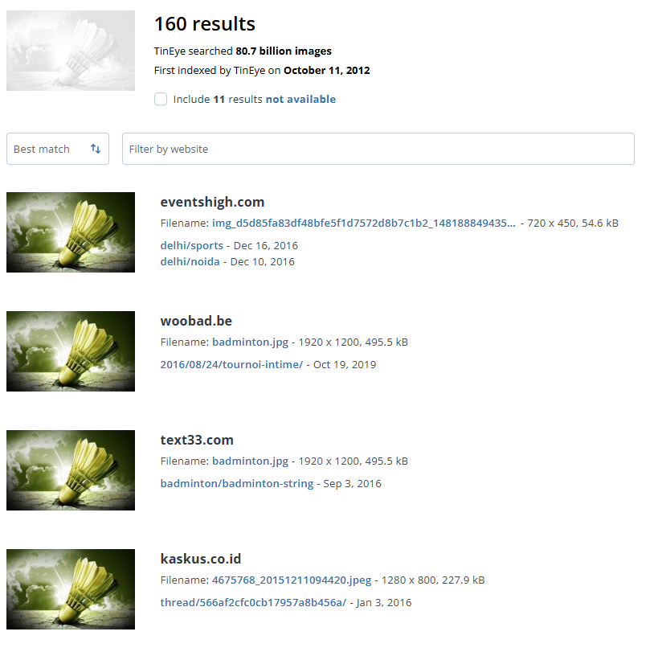
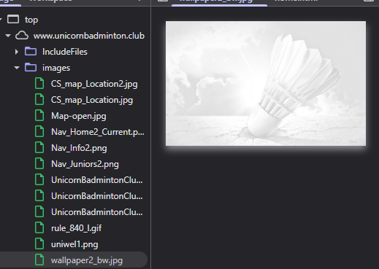
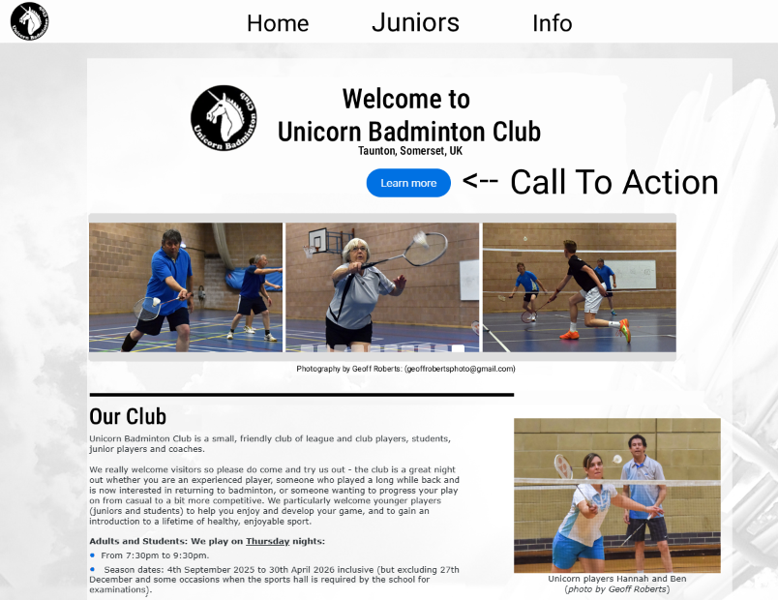
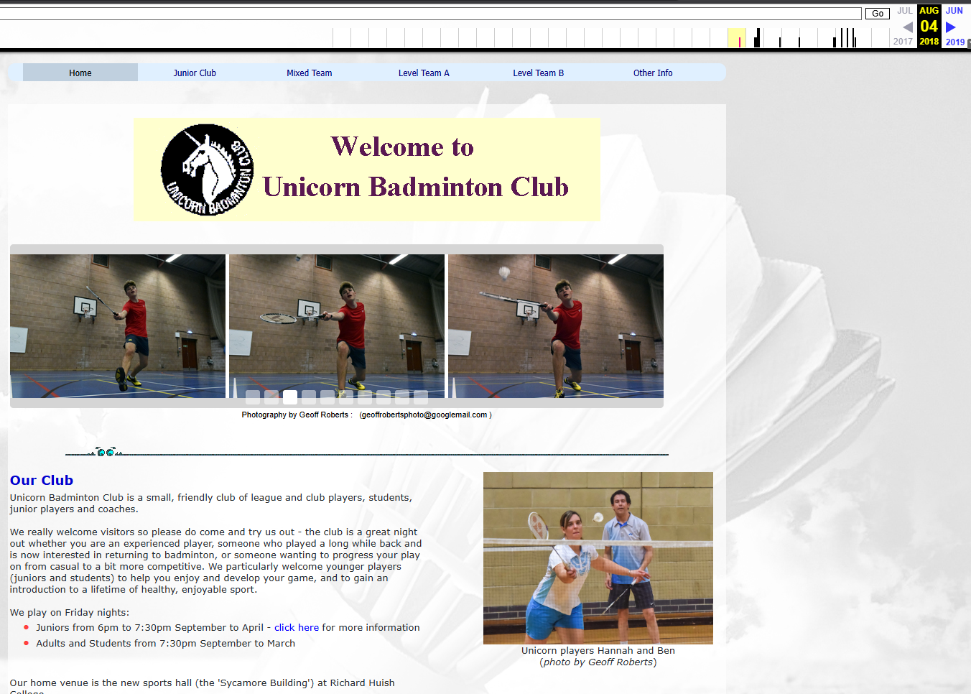
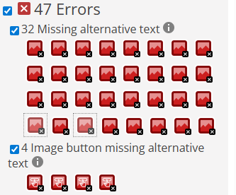

Recommendations
Copyright Infringement The Unicorn Badminton Club background image is an edited version of a widely distributed stock image that appears across hundreds of unrelated websites. If this is an unlicensed asset, it presents significant risks for their business. modifying an image through recolouring does not bypass copyright, it can be viewed as an "adaptation“ done without the original creator's permission. For a business, this means high liability for significant financial penalties and brand damage. Section 16 of the CDPA backs this up and grants owners the exclusive rights to “copy” or “adapt” their work. Recolouring the image without a license or explicit permission to do so would breach these rights.
Desktop & Mobile Design It’s important to have a layout that supports Mobile / Handheld devices as 60% of web traffic is made up by mobile devices, this can be done by using the bootstrap grid system. Incorporating mobile design will make the website appear more engaging as it’ll be easily readable on smaller devices, if information is better communicated it may result in enhanced user experience and as a result increased membership sign ups & engagement.
Additionally, Section 97(2) of the CDPA states the courts can award “additional damages” if the breach is deemed “flagrant” (reckless) a real-world case Absolute Lofts v Artisan Home Improvements (2015) Sought to find that flagrant misuse of images used to create “unfair profits” irrespective of the original copyright holders' rights, the courts found in favour of the copyright holder which cost the business over £6000, a blow that could be detrimental to the survival of a small business such as the UBC, as a result they should immediately remove this image, as to not incur similar punishment as the wayback machine indicates they have been using this image since 2018.
Thorough testing Testing must be done to identify Performance issues (long load times) / Accessibility issues (Missing alt text) Decreasing the time the webpage takes to load could be beneficial to UBC, while already ‘ok’, Light house reports indicate they can likely cut back further on file sizes by compressing them decreasing the time to LCP (rendering of the largest visible image displayed)
The WAVE report Currently indicates issues with accessibility. I also recommend that they use WAVE as alt-text is primarily used for screen readers in people who commonly have issues such as poor eyesight or learning difficulties such as dyslexia.
How UBC could implement a CTA With a simple slightly more modern design To incorporate it.
Calls to Action / CTAs
Current website is too plain; nothing is contrasting. There’s no way to register online, consider implementing a booking system and include buttons that are CTAs such as ‘SIGN UP HERE’ or ‘JOIN A SESSION’, these may change general interest into action.

Slide 6
Competitive advantage within business scenario
Based in a local community, long-standing reputation with over 50 years in business, strong identity.
Clear goals are outlined, development pathway for juniors taking them from beginners to improvers until they reach a standard of competitive professional play.
Sessions are consistent, times of play are clearly listed; reliable timetable will retain members who need to fit the sessions around their personal life i.e. work obligations.
Membership is affordable, no hidden fees good value over private 1:1 coaching.
The Taunton location has multiple areas that feed into Taunton where the club is based, acting as a central location for the catchment.
This foundation positions the club to grow junior membership and retain long-term players.
Notes:
The club has a long history, it’s been around for over 50 years, they have a clear pathway for development especially for juniors, it has a central location that feeds in multiple areas in the catchment, the website must reinforce the strengths. Showing how and why they are reliable, showing their structured plans visibly, Improving these aspects may help convert their advantages into results when it comes to membership.
https://www.somersetcountygazette.co.uk/sport/9698824.unicorn-badminton-club-celebrates-50th-anniversary/

Slide 7
Proposed Web Development Methodology
Involve those who have a primary interest regularly throughout the project to make better decisions.
Plan realistic goals so that updates can be delivered in a reasonable timescale without jeopardizing the quality of choices made.
Utilising Agile Principles
Deliver value early, the priority is to satisfy the club by providing a website that works quickly, improving it over time, even later into Development. Look to get feedback on the site from coaches, parents and juniors to adapt the site to address the consumers desires. Deliver updates frequently, such as increasing SEO ranking, or adding calls to action that entice potential customers to take action to sign up.
Focus on simplicity with continuous attention to technical excellence. Prioritizing the essential features first (session times, location, mobile layout, calls to action, pricing, contact info). Performance, accessibility and mobile usability testing throughout. Fix problems as they occur.
Notes:
This proposed web development methodology utilizes Agile principles such as early delivery, collaboration with businesspeople and consumers, while ensuring continuous improvement. It’s an ideal methodology for a website that is reliant on feedback to meet members needs and expectations overtime. Agile suits this project as there's a lot that needs to be improved on, unlike waterfall Agile allows you to make iterations on former stages in the development cycle, which is crucial for Unicorn as they require a lot of modernisation, other methodologies may end up with oversights being left in because of not being able to go back to other stages. Deliver value early, the priority is to satisfy the club by providing a website that works quickly, improving it over time, even later into Development. Look to get feedback on the site from coaches, parents and juniors to adapt the site to address the consumers desires. Deliver updates frequently, over a couple of weeks to a couple of months, such as increasing SEO ranking, or adding calls to action that entice potential customers to take action to sign up.
Involve those who have a primary interest (club committee, coaches and members) daily / regularly throughout the project to make better decisions.
Plan realistic goals so that updates can be delivered in a reasonable timescale without jeopardizing the quality of choices made. Focus on simplicity with continuous attention to technical excellence. Prioritizing the essential features first (session times, location, mobile layout, calls to action, pricing, contact info). Performance, accessibility and mobile usability testing throughout. Not after finishing everything, fix problems as they occur. https://agilemanifesto.org/principles.html

Slide 8
Web Development Tools Evaluation
Testing – Lighthouse & WAVE Lighthouse can be used to test site performance Measuring how quick main content loads (LCP) Tracking layout stability during load (CLS) And to check responsiveness after user input. (INP) Lighthouse is useful to identify why loading times may be slow (may indicate images need compressing)
Lighthouse also directly supports the agile methodology as it identifies performance issues early helping them to be rectified before they spiral out of control which may affect deadlines One limitation of Lighthouse is scores will not always reflect real conditions on devices, if a user has a particularly slow network connection is on a slower device or a different browser it may affect individual experiences
Figma – Design & Prototyping Figma allows for collaboration with committee members and allows for real time feedback making designs tailorable to their needs. Gives a realistic outlook for how the website may look when applied in visual studio, plan saves time & helps with visualisation.
However, Figma may be confusing to onlookers who’ve never used the service and may mistake it for a 1:1 of how the website will look when created however its primary purpose is to be used to plan and changes may be made later down the line, this reinforces why following agile principles is essential as businesspeople and developers must work with and update one another so that they understand this nuance.
WAVE WAVE is a tool that scans a webpage highlighting issues such as missing alt text, poor colour contrast & poor use of headings, it shows the points on the page that may have these issues so that developers can rectify them as they directly correlate to accessibility.
(Screen readers read alt-text aloud so visually impaired users can understand the purpose of an image.) WAVE is necessary for this project as it ensures that users do not miss out on opportunities due to their disability. One limitation of WAVE is that it can tell you if an image is missing alt-text however the alt-text may not necessarily be meaningful (images are visible enough even for someone who utilises a screen reader) Regardless, alt-text is important as it helps with SEO as search engines can’t visualise images however alt-text can tell them what an image represents (helps ranking for keywords)
Version Control GitHub should be used to track changes, so that progress is never lost. GitHub also supports collaboration, team members can create separate branches separate from the main branch to develop features independently, they can then merge them with the main branch when ready. Version control ensures updates are organised, reducing the risk of errors, it also enables efficient workflow as multiple people can work without overwriting one another’s changes Additionally, GitHub allows you to revert to earlier versions in case something critical breaks essential for getting projects out on time if there are issues you do not need to work from scratch!
Visual Studio Code – Code Editor
Visual studio code is a lightweight extensible code editor, which supports plugins that allow for the testing during web development supporting the critical files that make up a web pages such as HTML, CSS & JS. VSC should be used this project as it is ideal for building small responsive websites that suit the agile methodology.
One limitation is that you must be confident with these languages to build the website, it’s not alike to other website builders which provide drag and drop templates such as WIX or Squarespace that most competent people can use to build a website.
Notes:
Visual Studio Code – Code Editor
Visual studio code is a lightweight extensible code editor, which supports plugins that allow for the testing during web development supporting the critical files that make up a web pages such as HTML, CSS & JS. VSC should be used this project as it is ideal for building small responsive websites that suit the agile methodology.
One limitation is that you must be confident with these languages to build the website, it’s not alike to other website builders which provide drag and drop templates such as WIX or Squarespace that most competent people can use to build a website. Figma – Design & Prototyping Figma allows for collaboration with committee members and allows for real time feedback making designs tailorable to their needs. Gives a realistic outlook for how the website may look when applied in visual studio, plan saves time & helps with visualisation.
However, Figma may be confusing to onlookers who’ve never used the service and may mistake it for a 1:1 of how the website will look when created however its primary purpose is to be used to plan and changes may be made later down the line, this reinforces why following agile principles is essential as businesspeople and developers must work with and update one another so that they understand this nuance.
Version Control GitHub should be used to track changes, so that progress is never lost. GitHub also supports collaboration, team members can create separate branches separate from the main branch to develop features independently, they can then merge them with the main branch when ready. Version control ensures updates are organised, reducing the risk of errors, it also enables efficient workflow as multiple people can work without overwriting one another’s changes Additionally, GitHub allows you to revert to earlier versions in case something critical breaks essential for getting projects out on time if there are issues you do not need to work from scratch!
Testing – Lighthouse & WAVE Lighthouse can be used to test site performance Measuring how quick main content loads (LCP) Tracking layout stability during load (CLS) And to check responsiveness after user input. (INP) Lighthouse is useful to identify why loading times may be slow (may indicate images need compressing)
Lighthouse also directly supports the agile methodology as it identifies performance issues early helping them to be rectified before they spiral out of control which may affect deadlines One limitation of Lighthouse is scores will not always reflect real conditions on devices, if a user has a particularly slow network connection is on a slower device or a different browser it may affect individual experiences
WAVE WAVE is a tool that scans a webpage highlighting issues such as missing alt text, poor colour contrast & poor use of headings, it shows the points on the page that may have these issues so that developers can rectify them as they directly correlate to accessibility.
(Screen readers read alt-text aloud so visually impaired users can understand the purpose of an image.) WAVE is necessary for this project as it ensures that users do not miss out on opportunities due to their disability. One limitation of WAVE is that it can tell you if an image is missing alt-text however the alt-text may not necessarily be meaningful (images are visible enough even for someone who utilises a screen reader) Regardless, alt-text is important as it helps with SEO as search engines can’t visualise images however alt-text can tell them what an image represents (helps ranking for keywords)
https://pagespeed.web.dev/analysis/https-www-unicornbadminton-club-home-html/ztc3gzyrvr?form_factor=desktop https://wave.webaim.org/report#/https://www.unicornbadminton.club/home.html

Slide 9
Web Frameworks Evaluation
HTML, CSS & JavaScript Full control over structure and styling. Lightweight and fast for small websites. Ideal for implementing accessibility and performance fixes. Requires manual development & preexisting knowledge of languages.
Bootstrap (CSS Framework) Provides a responsive grid system that adapts layouts across different devices using mobile‑first components Speeds up layout and design consistency by offering ready‑made, well‑structured UI elements Helps modernise the site quickly with pre‑built components that reduce development time Can look generic if not customised because many sites use the same default Bootstrap components.
Recommended Approach
Overall combining HTML/CSS/JS with bootstrap would be ideal offering full control over decisions such as structure and styling, while bootstrap provides the utilities to create a responsive mobile layout which the current site lacks.
Notes:
Benefits of using HTML CSS & JS (standard in web development) as well as the benefits of incorporating a CSS framework such as bootstrap.
HTML CSS & JS allow for full control over the websites structure, styling and behaviour. Access over these factors is necessary for the club’s website where performance and accessibility are a priority, Other platforms that provide the ability to ‘drag and drop templates’ such as Wix or Squarespace may include unnecessary code in their elements that may harm performance, Manual development can remove this excess code which will result in faster load times due to the developer having freedom of expression over their code. However, because of using a manual developer this approach requires a competent developer who has a solid understanding of the languages involved, which may harm future updates if the club choose to not stay involved with the former developer, and if they hire another developer in the future, it may take a while for them to get acquainted with the pre-existing code as it may not be in their style leading to updates taking longer or an entire rebuild being necessary. Bootstrap provides a responsive grid system and pre-built components which speed up development and ensure consistency across pages, bootstrap is useful for improving their mobile layout and responsiveness which is currently a significant weakness to the Unicorn Badminton Club. Bootstrap automatically adjusts layout dependant on the device being used which is essential as mobile & other handheld devices make up around 60% of total web traffic, if Unicorn fail to implement mobile responsiveness, they may alienate over half of the potential userbase that interact with the website as they may become dissatisfied as the website looks unprofessional and is harder to interact with. The main limitation is that Bootstrap can look generic if not customised. Many sites use the same default navbars, buttons, and layout styles, so without branding or design tweaks, the site may feel templated alike to web-building platforms rather than unique. Overall combining HTML/CSS/JS with bootstrap would offer the best of both worlds, offering full control over decisions such as structure and styling, while bootstrap provides the utilities to create a responsive mobile layout which is currently a limitation which the current site lacks, Including both together ensures the website can provide a cross compatible, fast experience across devices

Slide 10
Solution of Web Development Tools & Frameworks
Use Visual Studio Code as the primary code editor. Supports HTML, CSS & JS with plugins such as Live-server that streamline iterative development in line with agile principles Use Figma for planning and prototyping Enables collaborative design with committee members allowing for rapid feedback and visualisation of layouts before development begins, supports agile emphasis on involvement between businesspeople and developer. Build using HTML, CSS & JS Offers control over structure, styling and behaviour, keeps the page lightweight fast and accessible, issues are trouble shootable as the site won’t use pre-defined template code like other web builders. Combine Bootstrap for Mobile & Cross device layouts. Provides a responsive grid system that ensures the web page is consistent across devices, elements will automatically adjust based on screen size, ensuring layout stays consistent across devices
Notes:
Tools and frameworks selected to support Agile principles and address the main priorities for web development.

Slide 11
Conclusion & Next Steps
Create wireframes and prototypes in Figma to visualise the new layout and gather early feedback from coaches, parents and committee members.
Begin iterative development in Visual Studio Code, building core pages first (sessions, pricing, contact, location) before refining styling and responsiveness.
Replace all potentially unlicensed images with original or royalty‑free alternatives to eliminate legal risk and strengthen brand identity.
Conduct ongoing testing using Lighthouse and WAVE to monitor performance, accessibility and mobile usability throughout development.
Implement clear calls to action and improved content structure to support membership growth and communicate the junior development pathway effectively.
Launch the updated site and gather post‑deployment feedback, using real user behaviour to guide further improvements.
The current Unicorn Badminton Club website is functional but outdated, lacking modern design, accessibility compliance, and mobile responsiveness.
Analysis shows clear weaknesses in layout, navigation, image licensing, and performance, all of which limit the club’s ability to attract and retain members.
The recommended solution HTML/CSS/JS with Bootstrap, supported by Agile development, continuous testing.

Slide 12
References
Legislation & Case Law
Copyright, Designs and Patents Act 1988. Available at: https://www.legislation.gov.uk/ukpga/1988/48/contents
Absolute Lofts South West London Ltd v Artisan Home Improvements Ltd [2015] EWHC 2608 (IPEC). Available at: https://nipclaw.blogspot.com/2015/09/damages-for-infringing-copyright-in.html
Image Licensing & Verification
TinEye. (2024) Reverse Image Search. Available at: https://tineye.com
Web Development Tools & Documentation
Google. Lighthouse. Available at: https://developers.google.com/web/tools/lighthouse
WebAIM. WAVE Web Accessibility Evaluation Tool. Available at: https://wave.webaim.org
Bootstrap. Bootstrap Documentation. Available at: https://getbootstrap.com/docs
Design, Version Control & Statistics
Figma. Figma: Collaborative Interface Design Tool. Available at: https://www.figma.com
GitHub. GitHub Documentation. Available at: https://docs.github.com
Statista. Mobile Internet Traffic Worldwide. Available at: https://www.statista.com/statistics/277125/share-of-website-traffic-coming-from-mobile-devices/ Agile Principles Agile Alliance (n.d.) Principles behind the Agile Manifesto. Available at: https://agilemanifesto.org/principles.html

